Slide 2
Carbon: The Backbone of Life
Living organisms consist mostly of carbon-based compounds
Carbon is unparalleled in its ability to form large, complex, and varied molecules
Proteins, DNA, carbohydrates, and other molecules that distinguish living matter are all composed of carbon compounds

Slide 3

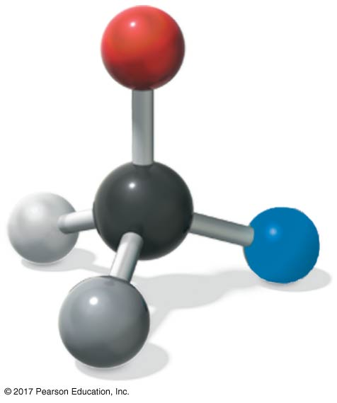
Figure 4.1
What properties make carbon the basis of all life?
carbon atom
© 2018 Pearson Education Ltd.
Notes:
Figure 4.1 What properties make carbon the basis of all life?

Slide 4
Concept 4.1: Organic chemistry is the study of carbon compounds
Organic chemistry is the study of compounds that contain carbon, regardless of origin
Organic compounds range from simple molecules to colossal ones

Slide 5
Organic Molecules and the Origin of Life on Earth
Stanley Miller’s classic experiment demonstrated the abiotic synthesis of organic compounds
Experiments support the idea that abiotic synthesis of organic compounds, perhaps near volcanoes, could have been a stage in the origin of life

Slide 6
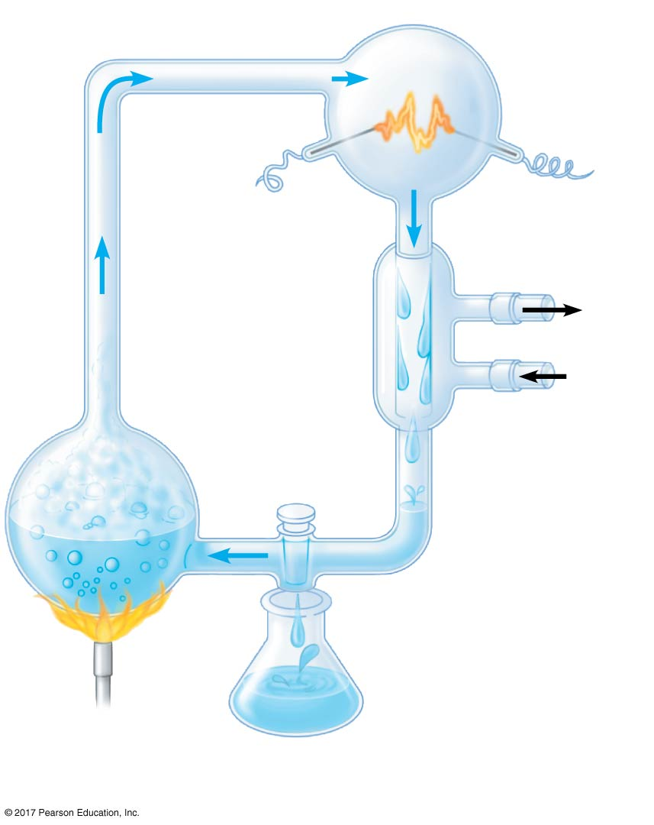
Figure 4.2
“Atmosphere”
CH₄
Water vapor
Electrode
NH₃
H₂
Condenser
Cooled “rain”
containing
organic
molecules
Cold
water
Can organic molecules form under conditions estimated to simulate those on the early Earth?
H₂O
“sea”
Sample for
chemical analysis
© 2018 Pearson Education Ltd.
Notes:
Figure 4.2 Inquiry: Can organic molecules form under conditions estimated to simulate those on the early Earth?

Slide 7
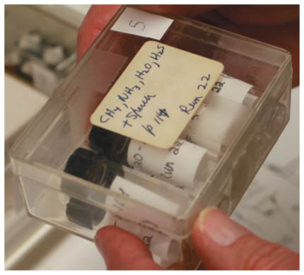
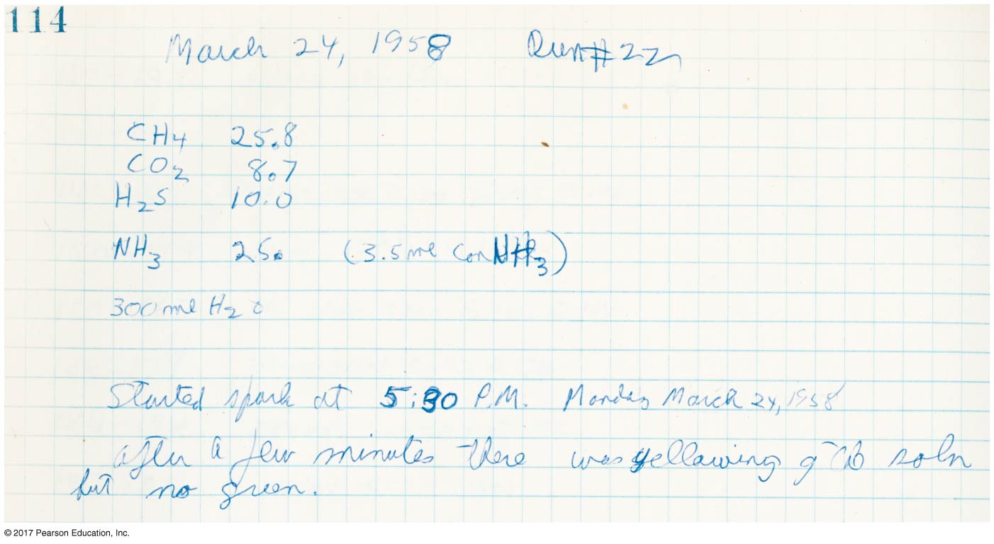
Figure 4.UN01b
Miller’s notes
Miller’s original vials
© 2018 Pearson Education Ltd.
Notes:
Figure 4.UN01b Working with moles and molar ratios (part 2: Miller’s notes)

Slide 8
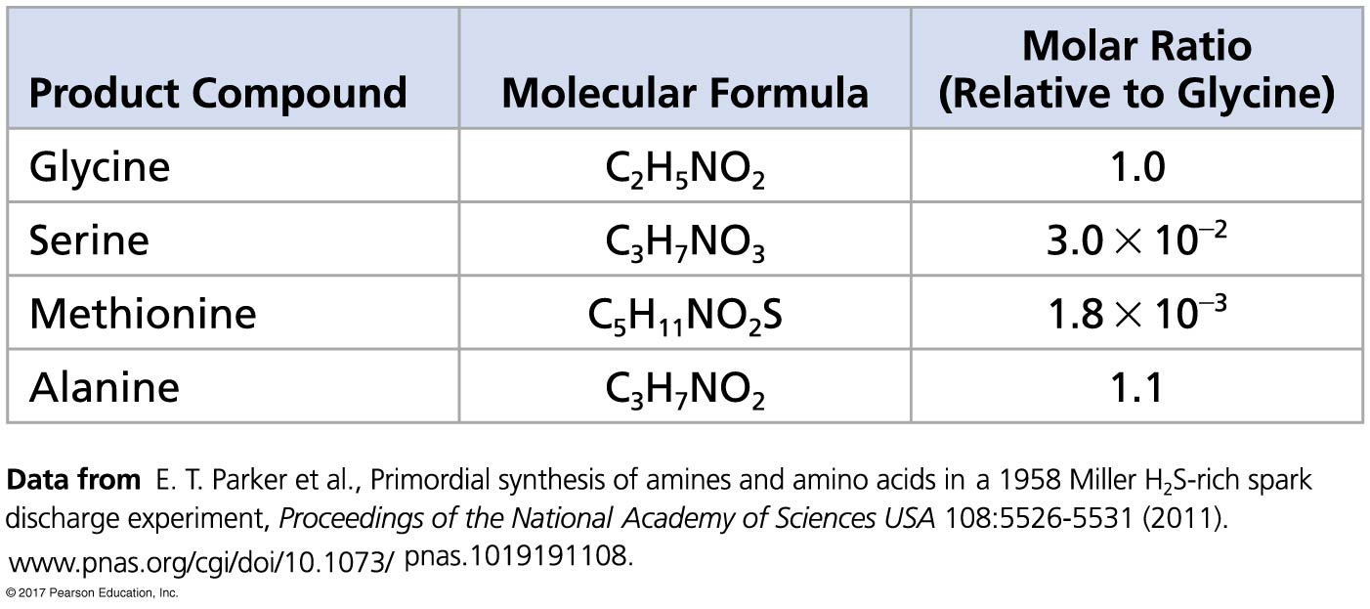
Figure 4.UN01a
Experiment data
© 2018 Pearson Education Ltd.
Notes:
Figure 4.UN01a Working with moles and molar ratios (part 1: experiment data)

Slide 9
The overall percentages of the major elements of life—C, H, O, N, S, and P—are quite uniform from one organism to another
Because of carbon’s ability to form four bonds, these building blocks can be used to make an inexhaustible variety of organic molecules
The great diversity of organisms on the planet is due to the versatility of carbon

Slide 10
Concept 4.2: Carbon atoms can form diverse molecules by bonding to four other atoms
Electron configuration電子組態is the key to an atom’s characteristics
Electron configuration determines the kinds and number of bonds an atom will form with other atoms

Slide 11
The Formation of Bonds with Carbon
With four valence electrons, carbon can form four covalent bonds with a variety of atoms
This makes large, complex molecules possible
In molecules with multiple carbons, each carbon bonded to four other atoms has a tetrahedral shape
However, when two carbon atoms are joined by a double bond, the atoms joined to the carbons are in the same plane as the carbons

Slide 12
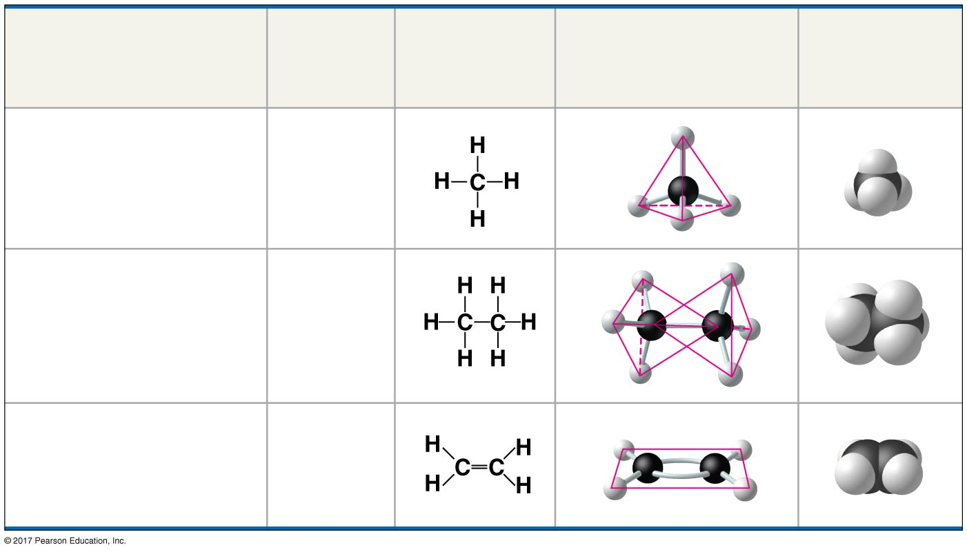
Figure 4.3
The shapes of three simple organic molecules
Molecule
Molecular
Formula
Structural
Formula
Ball-and-Stick Model
Space-Filling
Model
(a) Methane
CH₄
(b) Ethane
C₂H₆
(c) Ethene (ethylene)
C₂H₄
© 2018 Pearson Education Ltd.
Notes:
Figure 4.3 The shapes of three simple organic molecules

Slide 13
The number of unpaired electrons in the valence shell of an atom is generally equal to its valence, the number of covalent bonds it can form

Slide 14
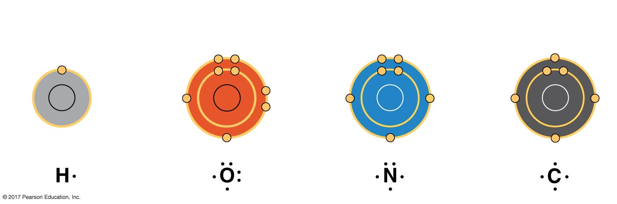
Figure 4.4
Valences of the major elements of organic molecules
Hydrogen
(valence = 1)
Oxygen
(valence = 2)
Nitrogen
(valence = 3)
Carbon
(valence = 4)
H
O
N
C
© 2018 Pearson Education Ltd.
Notes:
Figure 4.4 Valences of the major elements of organic molecules

Slide 15
The electron configuration of carbon gives it covalent compatibility with many different elements
The valences of carbon and its most frequent partners (hydrogen, oxygen, and nitrogen) are the building code for the architecture of living molecules

Slide 16
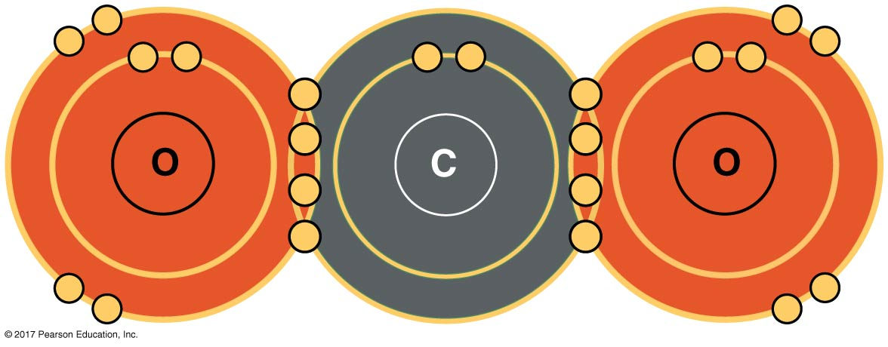
Carbon atoms can partner with atoms other than hydrogen, such as the following:
Carbon dioxide: CO₂
Notes:
Page 108, upper left column, CO2 figures, line diagram and showing valence shells

Slide 17
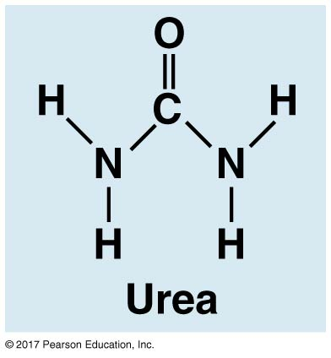
Urea: CO(NH₂)₂
Notes:
Page 108, upper left column, CO2 figures, line diagram and showing valence shells

Slide 18
Molecular Diversity Arising from Variation in Carbon Skeletons
Carbon chains form the skeletons of most organic molecules
Carbon chains vary in length and shape

Slide 19
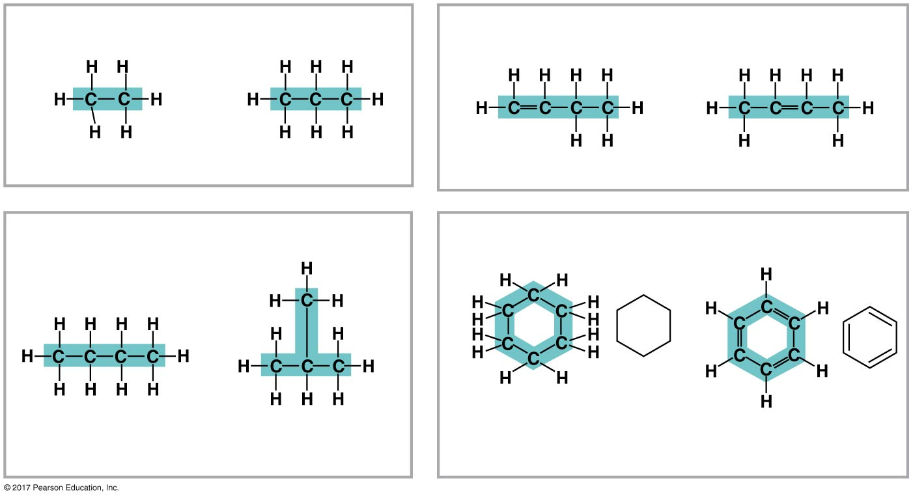
Figure 4.5
Four ways that carbon skeletons can vary
(a) Length
(c) Double bond position
Ethane
Propane
1-Butene
2-Butene
(b) Branching
(d) Presence of rings
Butane
2-Methylpropane
(isobutane)
Cyclohexane
Benzene
© 2018 Pearson Education Ltd.
Notes:
Figure 4.5 Four ways that carbon skeletons can vary

Slide 20
Hydrocarbons
Hydrocarbons(碳氫化合物) are organic molecules consisting of only carbon and hydrogen
Many organic molecules, such as fats, have hydrocarbon components
Hydrocarbons can undergo reactions that release a large amount of energy

Slide 21
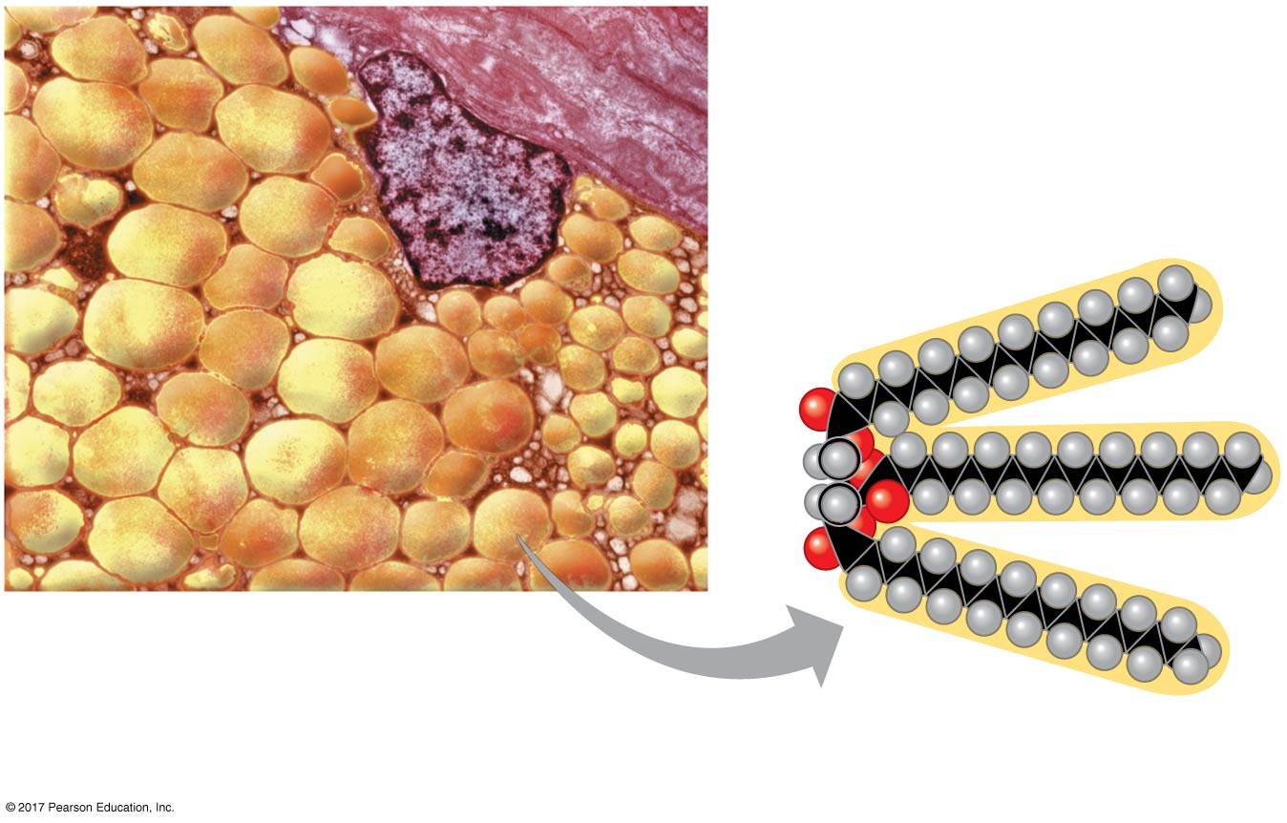
Figure 4.6
The role of hydrocarbons in fats
Nucleus
Fat droplets
10 µm
(a) Part of a human adipose cell
(b) A fat molecule
© 2018 Pearson Education Ltd.
Notes:
Figure 4.6 The role of hydrocarbons in fats

Slide 22
Isomers
Isomers are compounds with the same molecular formula but different structures and properties
Structural isomers結構異構have different covalent arrangements of their atoms
Cis-trans isomers順反異構物have the same covalent bonds but differ in their spatial arrangements
Enantiomers鏡像異構物are isomers that are mirror images of each other

Slide 23
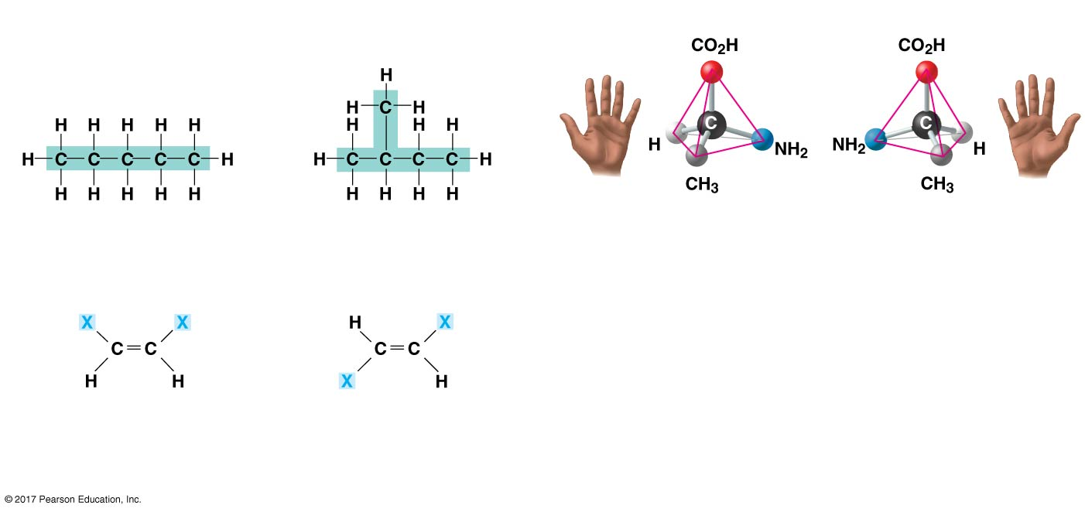
Figure 4.7
Three types of isomers
(a) Structural isomers
(c) Enantiomers
Pentane
2-Methylbutane
L isomer
D isomer
(b) Cis-trans isomers
cis isomer:
The two Xs are on
the same side.
trans isomer:
The two Xs are
on opposite sides.
© 2018 Pearson Education Ltd.
Notes:
Figure 4.7 Three types of isomers

Slide 24
Enantiomers are important in the pharmaceutical industry
Two enantiomers of a drug may have different effects
Usually, only one isomer is biologically active
Differing effects of enantiomers demonstrate that organisms are sensitive to even subtle variations in molecules

Slide 25
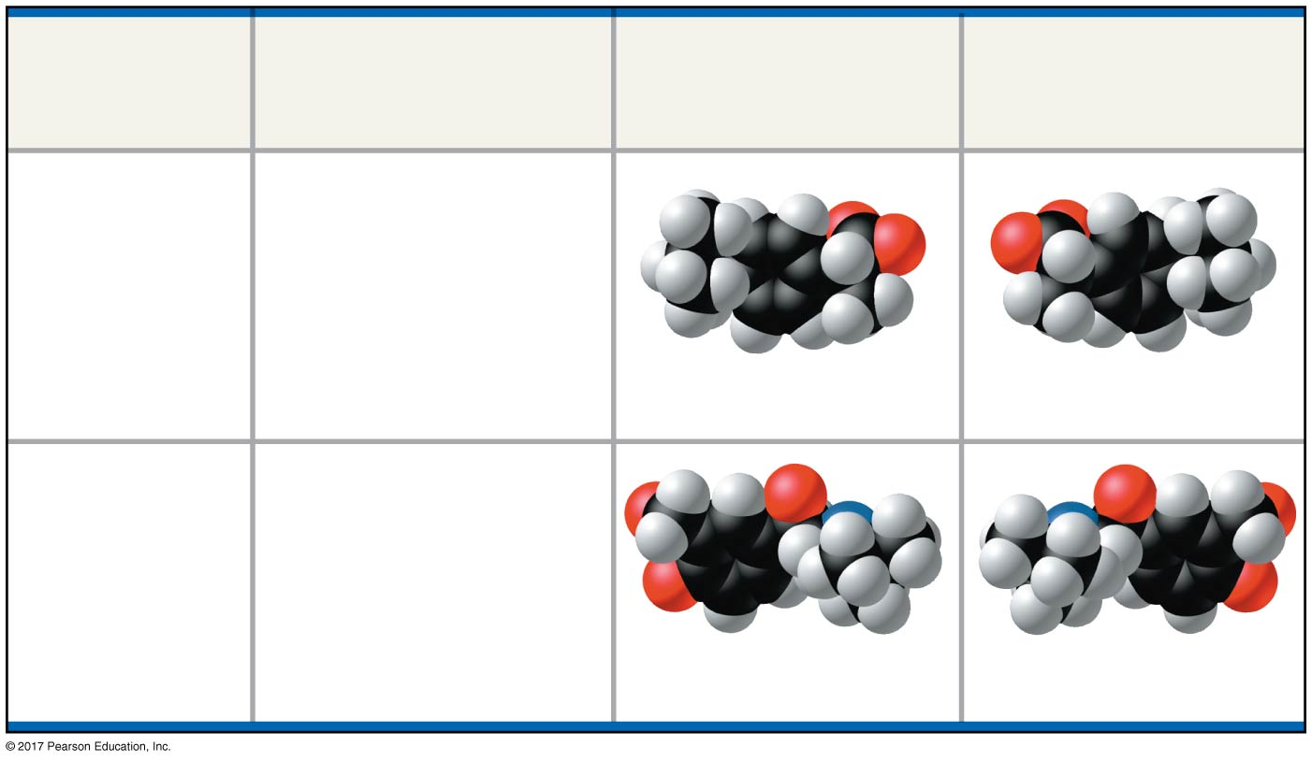
Figure 4.8
The pharmacological importance of enantiomers
Effective
Enantiomer
Ineffective
Enantiomer
Drug
Effects
Reduces
inflammation
and pain
Ibuprofen
S-Ibuprofen
R-Ibuprofen
Relaxes bronchial
(airway) muscles,
improving airflow
in asthma
patients
Albuterol
R-Albuterol
S-Albuterol
© 2018 Pearson Education Ltd.
Notes:
Figure 4.8 The pharmacological importance of enantiomers

Slide 26
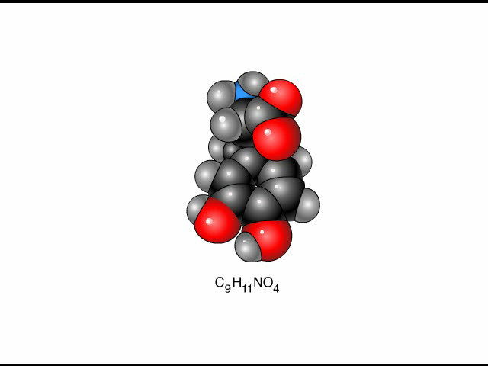
Animation: L-Dopa

Slide 27
Concept 4.3: A few chemical groups are key to molecular function
Distinctive properties of organic molecules depend on the carbon skeleton and on the chemical groups attached to it
A number of characteristic groups can replace the hydrogens attached to skeletons of organic molecules

Slide 28
The Chemical Groups Most Important in the Processes of Life
Estradiol and testosterone are both steroids with a common carbon skeleton, in the form of four fused rings
These sex hormones differ only in the chemical groups attached to the rings of the carbon skeleton

Slide 29
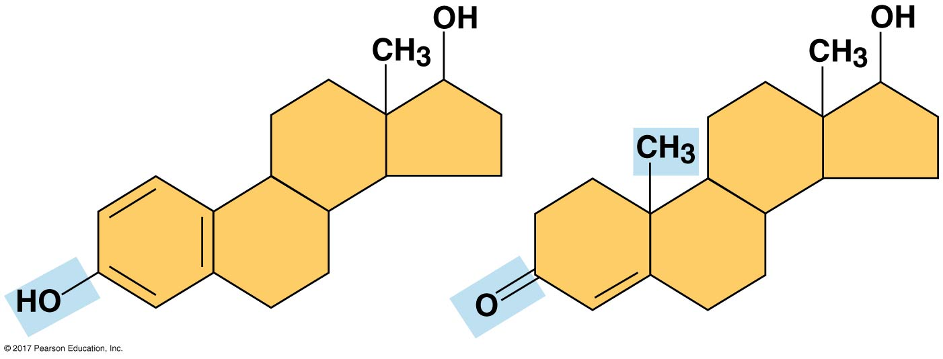
Figure 4.UN04
Sex hormones
Estradiol
Testosterone
© 2018 Pearson Education Ltd.
Notes:
Figure 4.UN04 In-text figure, sex hormones, p. 110

Slide 30
Functional groups 官能基are the components of organic molecules that are most commonly involved in chemical reactions
The number and arrangement of functional groups give each molecule its unique properties

Slide 31
The seven functional groups that are most important in the chemistry of life are the following:
Hydroxyl氫氧根group
Carbonyl羰基group
Carboxyl羧酸根group
Amino氨基group
Sulfhydryl硫氫基group
Phosphate磷酸鹽group
Methyl甲基group

Slide 32
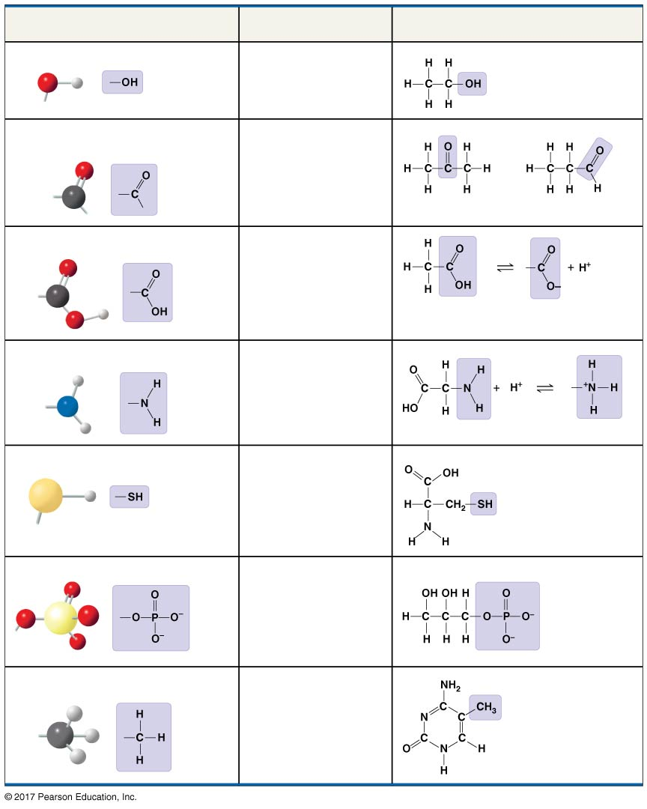
Figure 4.9
Chemical Group
Group Properties
Examples
Hydroxyl group (—OH)
Alcohol
Ethanol
Carbonyl group ( C ═ O)
Ketone
Aldehyde
Acetone
Propanal
Carboxyl group (—COOH)
Carboxylic acid
or organic acid
Acetic acid
Amino group (—NH₂)
Amine
Glycine
Sulfhydryl group (—SH)
Thiol
Cysteine
Phosphate group (—OPO₃²⁻)
Organic
phosphate
Glycerol
phosphate
Methyl group (—CH₃)
Methylated
compound
5-Methylcytosine
© 2018 Pearson Education Ltd.
Notes:
Figure 4.9 Some biologically important chemical groups

Slide 33
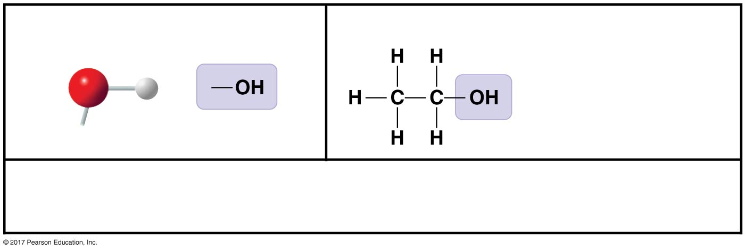
Figure 4.9aa
Hydroxyl group (—OH)
Ethanol, the alcohol
present in alcoholic beverages
(may be written HO—)
Polar due to electronegative oxygen. Forms hydrogen bonds with water.
Compound name: Alcohol
© 2018 Pearson Education Ltd.
Notes:
Figure 4.9aa Some biologically important chemical groups (part 1a: hydroxyl group)

Slide 34
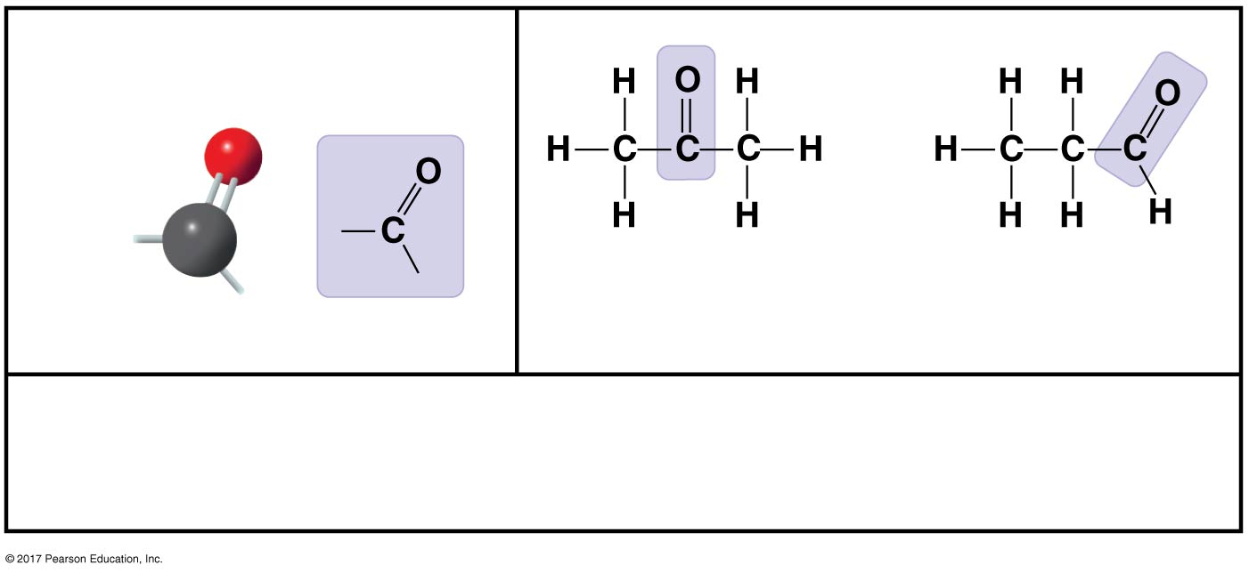

Figure 4.9ab
Carbonyl group ( C ═ O)
Acetone丙酮,
the simplest ketone
Propanal,
an aldehyde
Sugars with ketone groups are called ketoses; those with aldehydes
are called aldoses.
Compound name: Ketone酮or aldehyde醛
© 2018 Pearson Education Ltd.
Notes:
Figure 4.9ab Some biologically important chemical groups (part 1b: carbonyl group)

Slide 35
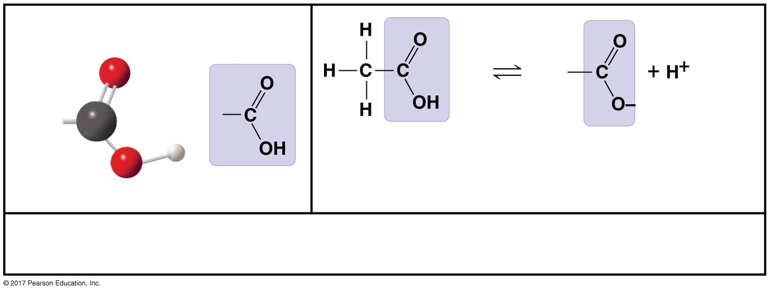
Figure 4.9ac
Carboxyl group (—COOH)
Acetic acid, which
gives vinegar its
sour taste
Ionized form of —COOH
(carboxylate ion),
found in cells
Acts as an acid.
Compound name: Carboxylic acid, or organic acid
© 2018 Pearson Education Ltd.
Notes:
Figure 4.9ac Some biologically important chemical groups (part 1c: carboxyl group)

Slide 36
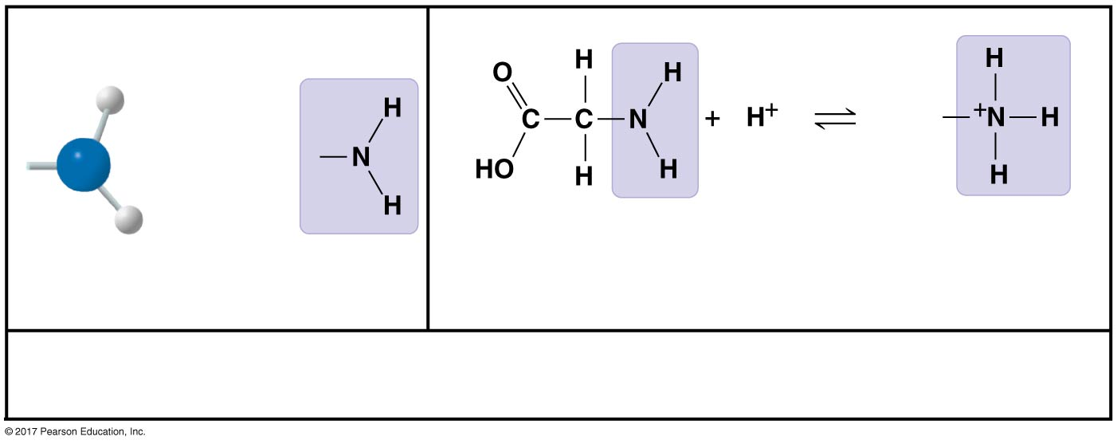
Figure 4.9ad
Amino group (—NH₂)
Glycine, an amino acid
(note its carboxyl group)
Ionized form
of —NH₂,
found in cells
Acts as a base.
Compound name: Amine
© 2018 Pearson Education Ltd.
Notes:
Figure 4.9ad Some biologically important chemical groups (part 1d: amino group)

Slide 37
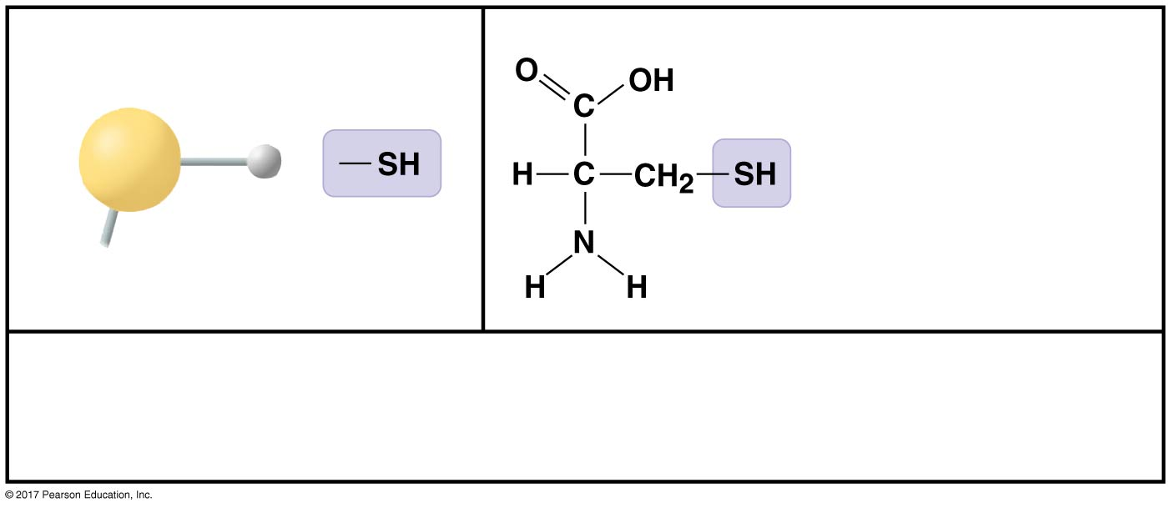
Figure 4.9ba
Sulfhydryl group (—SH)
Cysteine, a sulfur-
containing amino acid
(may be written HS—)
Two —SH groups can react, forming a “cross-link” that helps stabilize
protein structure.
Compound name: Thiol硫醇
© 2018 Pearson Education Ltd.
Notes:
Figure 4.9ba Some biologically important chemical groups (part 2a: sulfhydryl group)

Slide 38
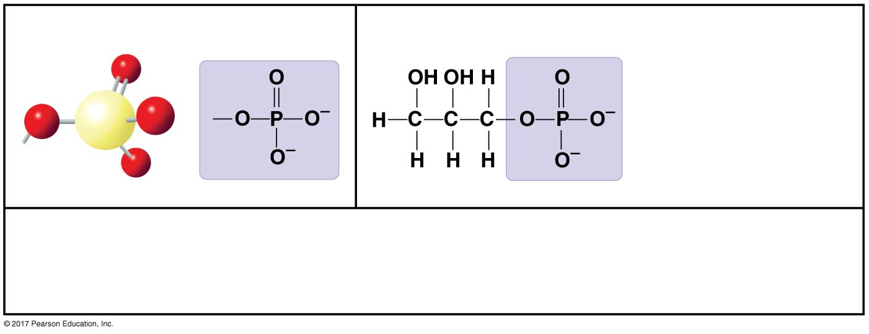
Figure 4.9bb
Phosphate group (—OPO₃²⁻)
Glycerol phosphate,
which takes part in
many important
chemical reactions
in cells
Contributes negative charge. When attached, confers on a molecule the
ability to react with water, releasing energy.
Compound name: Organic phosphate
© 2018 Pearson Education Ltd.
Notes:
Figure 4.9bb Some biologically important chemical groups (part 2b: phosphate group)

Slide 39
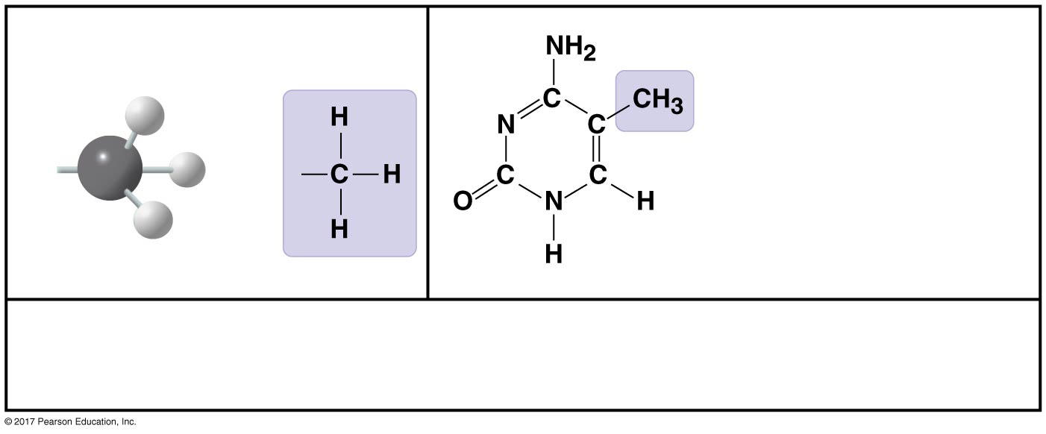
Figure 4.9bc
Methyl group (—CH₃)
5-Methylcytosine, a
component of DNA
that has been modified
by addition of a methyl
group
Affects the expression of genes. Affects the shape and function of
sex hormones.
Compound name: Methylated compound
© 2018 Pearson Education Ltd.
Notes:
Figure 4.9bc Some biologically important chemical groups (part 2c: methyl group)

Slide 40
ATP: An Important Source of Energy for Cellular Processes
An important organic phosphate is adenosine triphosphate三磷酸腺苷(ATP)
ATP consists of an organic molecule called adenosine attached to a string of three phosphate groups
ATP stores the potential to react with water
This reaction releases energy that can be used by the cell

Slide 41
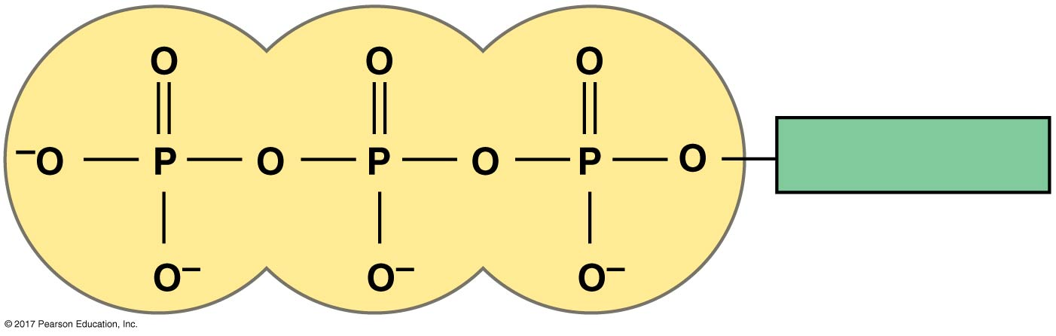
Figure 4.UN05
ATP phosphate chain
Adenosine
© 2018 Pearson Education Ltd.
Notes:
Figure 4.UN05 In-text figure, ATP phosphate chain, p. 112

Slide 42
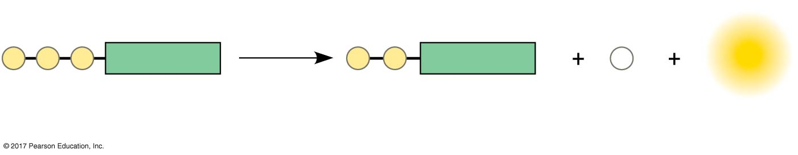
Figure 4.UN06
ATP to ADP reaction
Reacts
with H₂O
P
P
P
Adenosine
P
P
Adenosine
P
i
Energy
ATP
ADP
Inorganic
phosphate
© 2018 Pearson Education Ltd.
Notes:
Figure 4.UN06 In-text figure, ATP to ADP reaction, p. 112

Slide 43
The Chemical Elements of Life: A Review
The versatility of carbon makes possible the great diversity of organic molecules
Variation at the molecular level lies at the foundation of all biological diversity

